Slide 1
Lab 3
Finding Host-level TTPs using Kibana

Slide 2
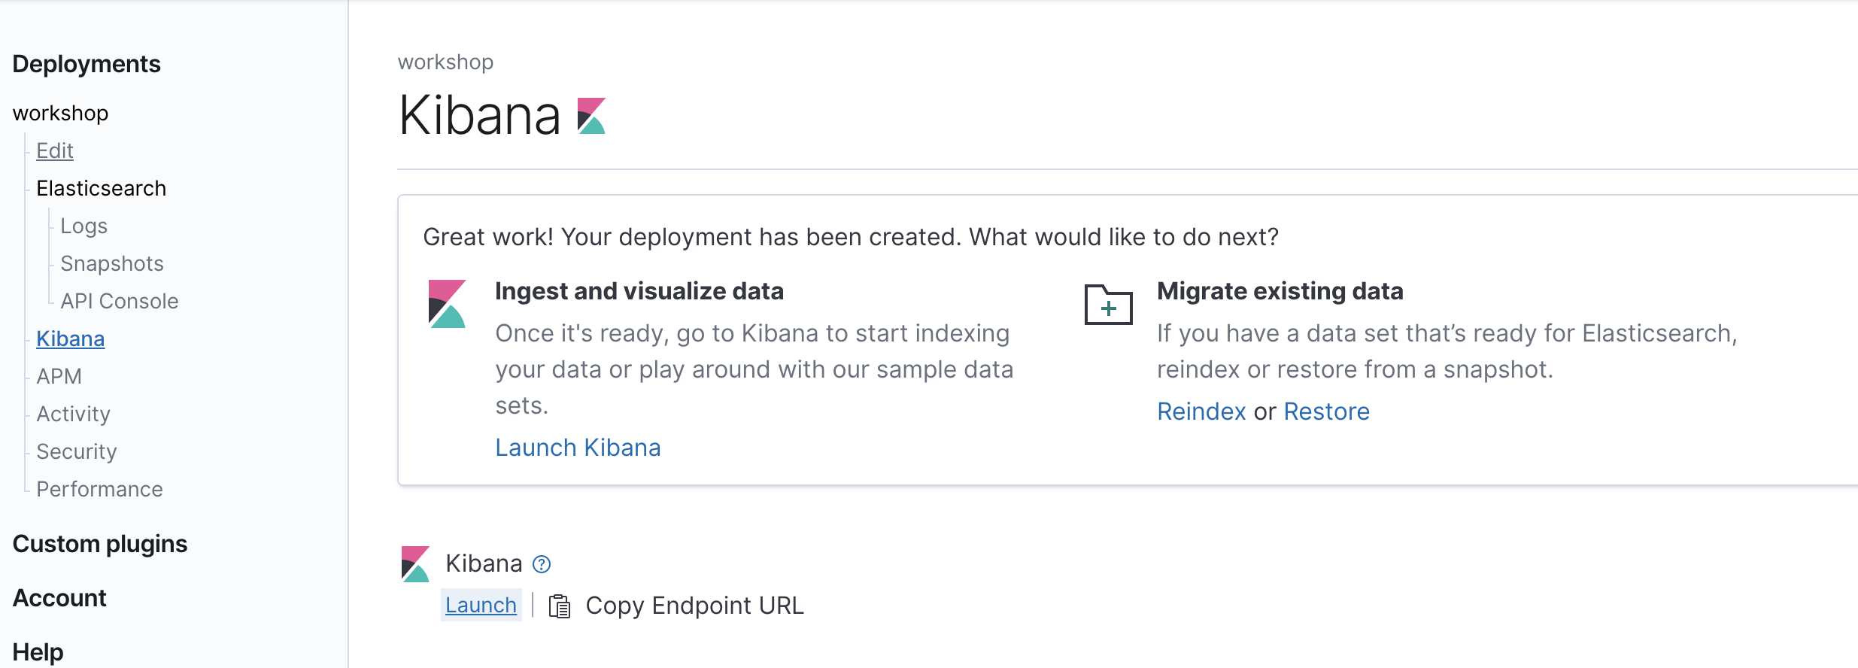
Launch Kibana from Cloud
Login to cloud.elastic.co account created in lab #1
1
Select Kibana under the newly created deployment.
2
Select Launch in the Kibana details.

Slide 3
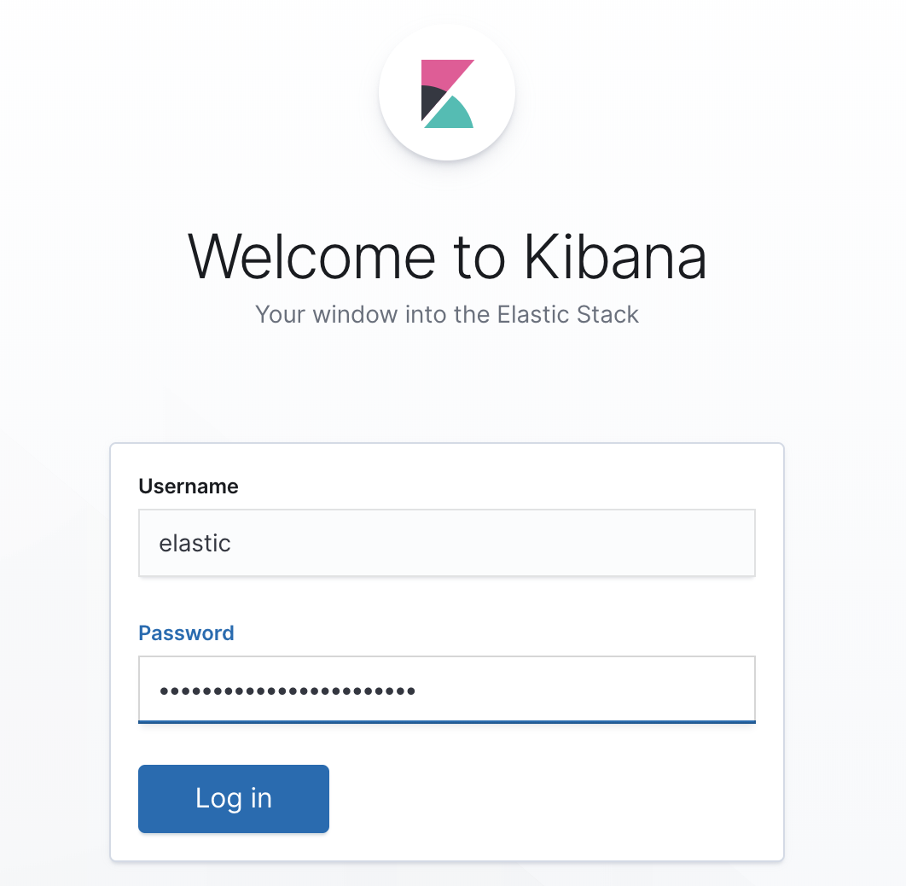
Log into Kibana
As user ‘elastic’
1
Username is: elastic
2
Copy-n-Paste the Cloud elastic user password saved in Lab #1.

Slide 4
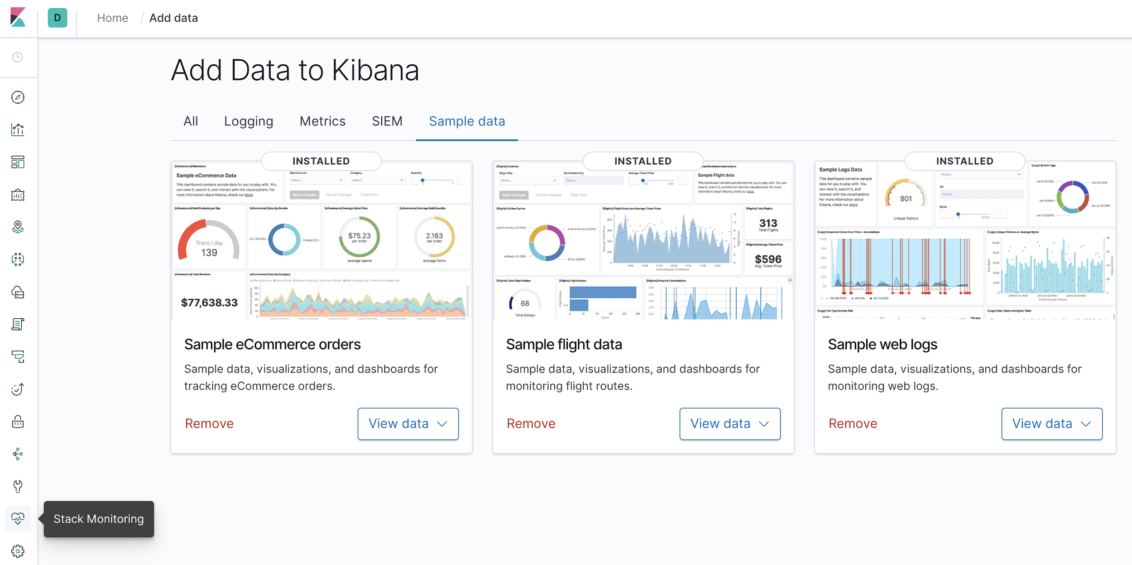
Navigate to Stack Monitoring
Second icon (heart) from the bottom left Navigation menu
1
Select Stack Monitoring

Slide 5
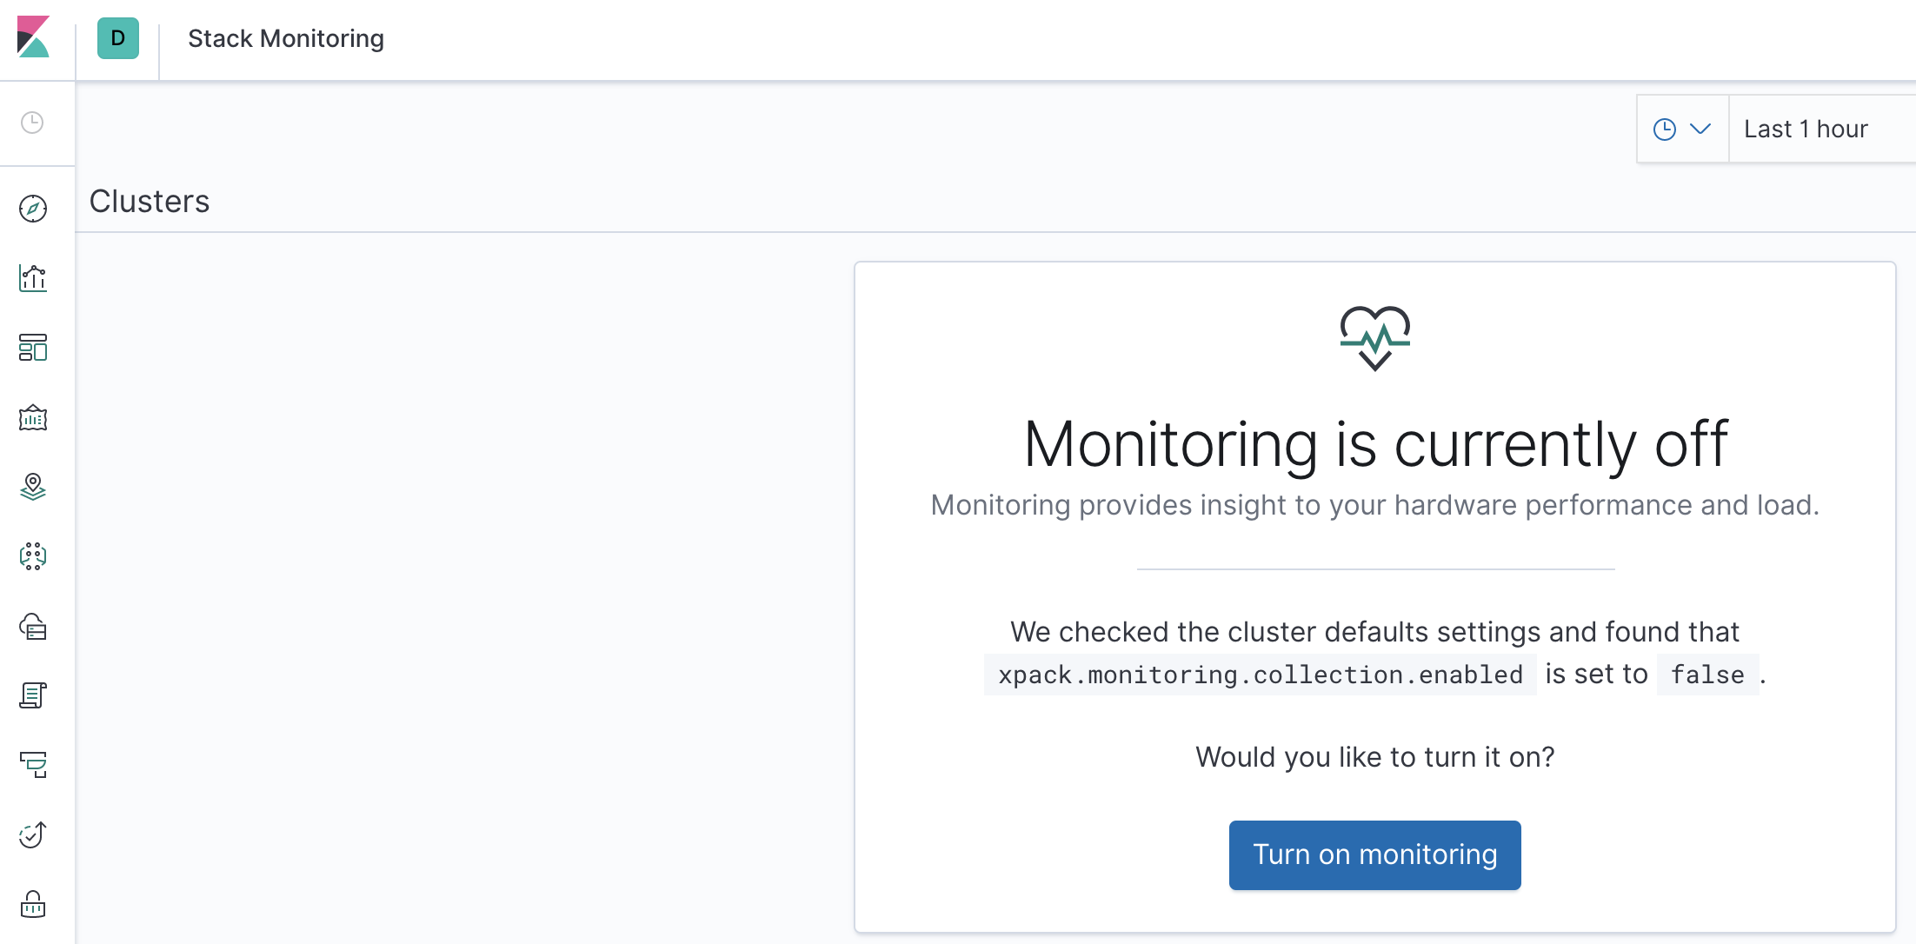
Enable Stack Monitoring
Stack monitoring lets you understand Elastic Cloud cluster performance
1
Select Turn on monitoring

Slide 6
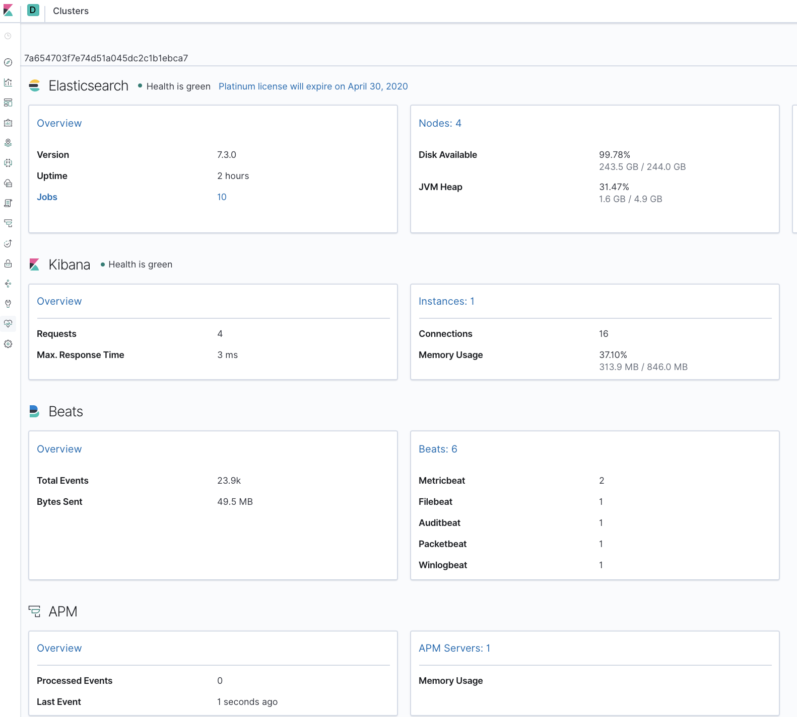
Ensure your Beats agents are online
After a few seconds, you should see 5 Beats enabled
1
5 Beats should be enabled
Notes:
Demo metrics from local cluster while waiting for metrics enablement to finish.
Local cluster monitoring demo (maybe local http://localhost:5601/app/monitoring#)
Navigate:
Clusters / Elasticsearch / Overview
search latency/rate
indexing latency/rate

Slide 7
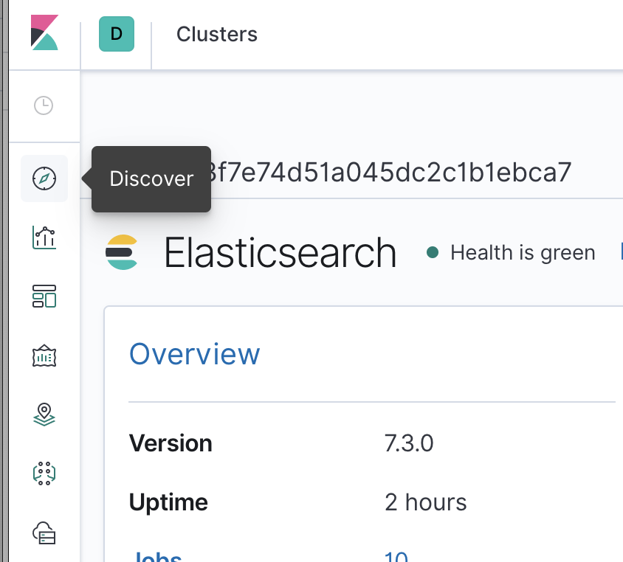
Move to the Discover app
Discovering what is in the data
1
Select ‘Discover’’

Slide 8
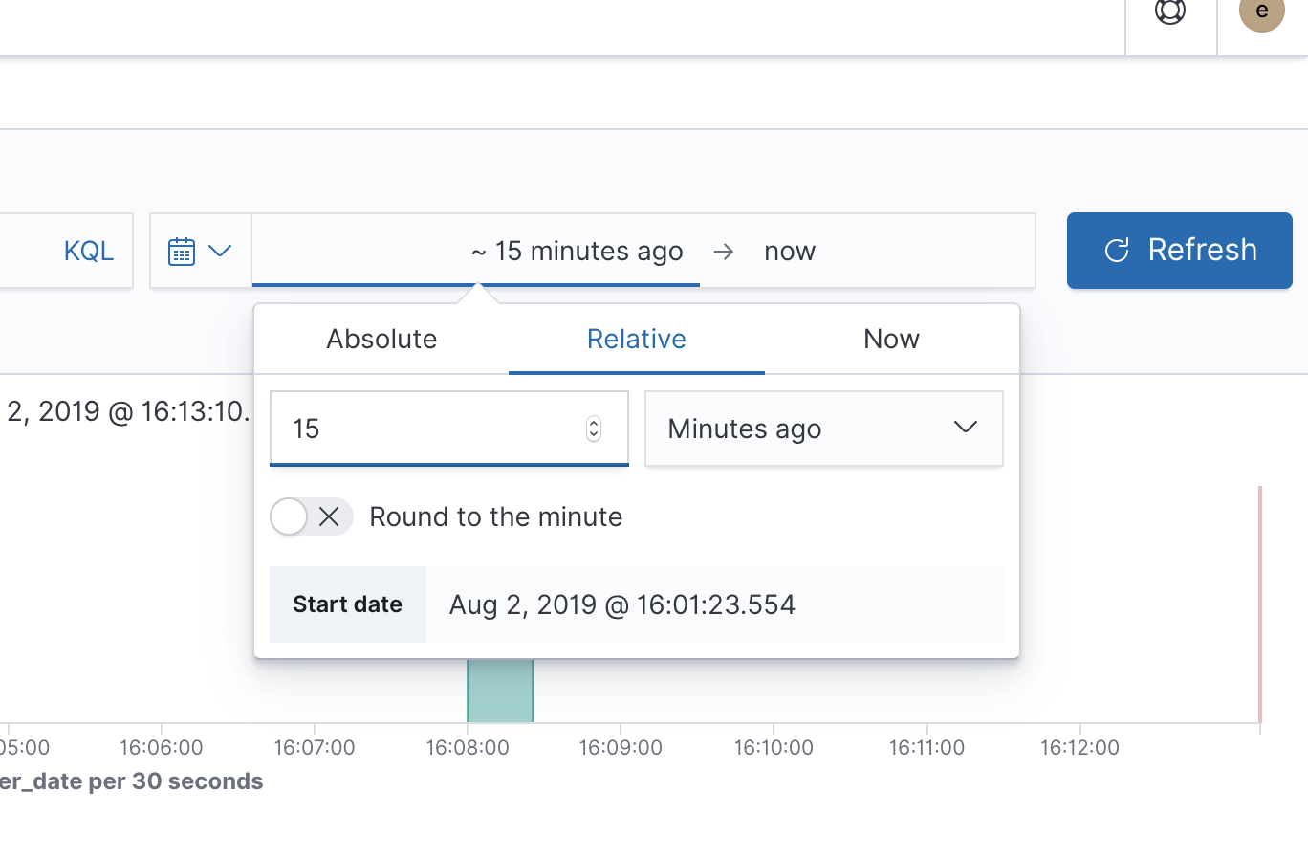
Setting the time range
Ensure it is set to the last 15 minutes
1
Select the calendar icon, Then set the last 15 minutes
2
Select Refresh

Slide 9
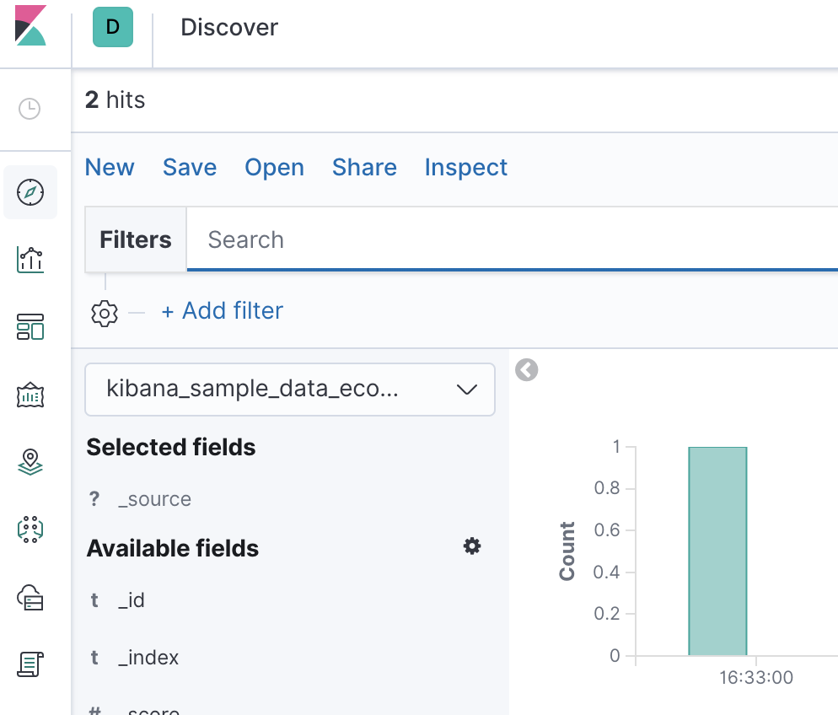
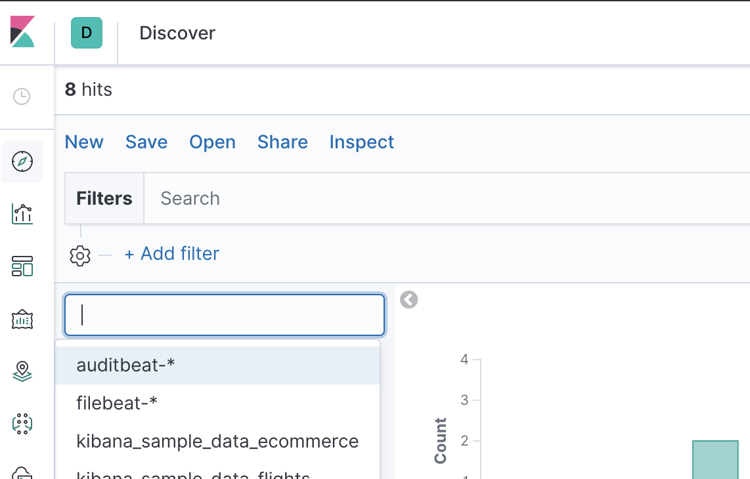
Select the index
Kibana has multiple indices, select auditbeat
1
Select the Index drop down menu under ‘Filter’ in the Discovery App
2
Select ‘auditbeat’

Slide 10
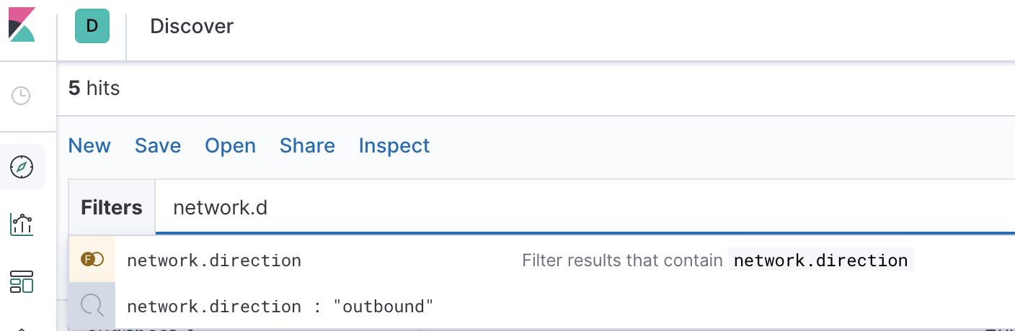
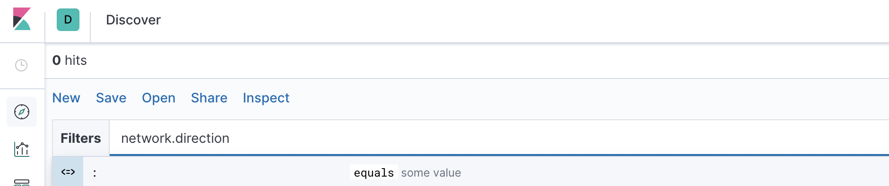
Search with KQL in Kibana
The default way to search
1
Type ‘network.d’ and select network.direction from the drop down menu
2
Select ‘equals some value’

Slide 11
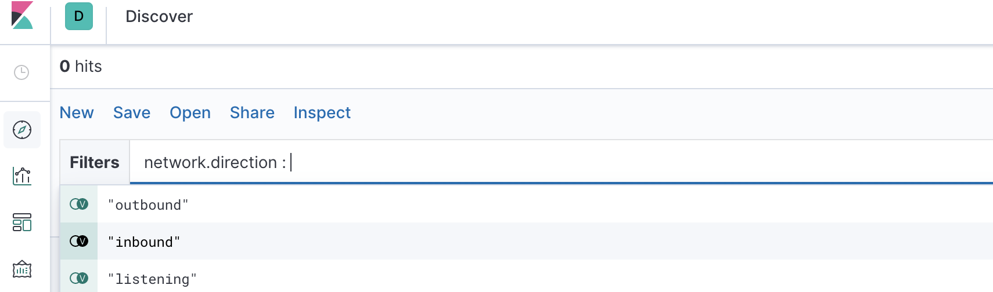
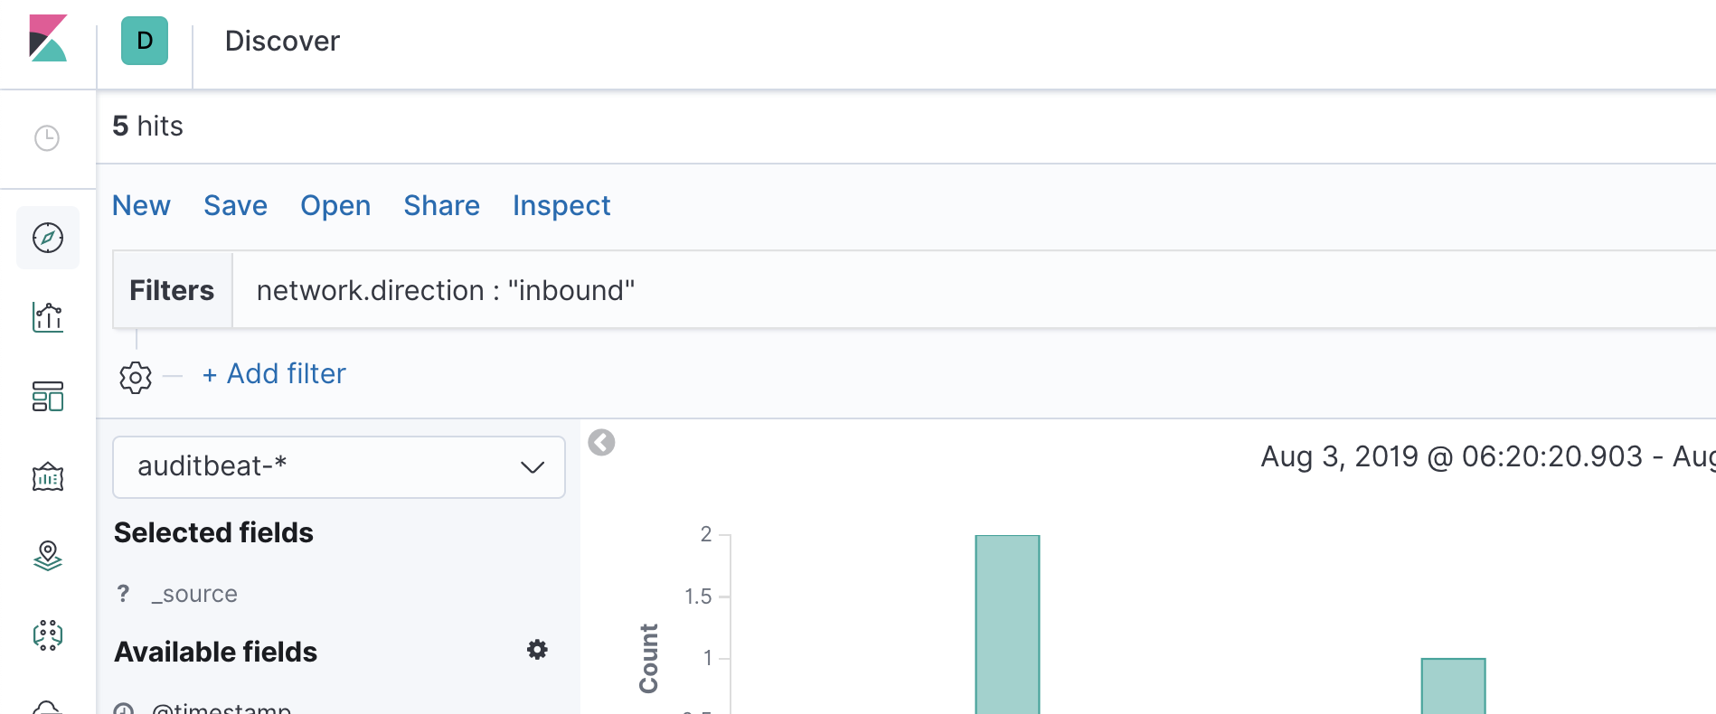
Search with KQL in Kibana
Search with autocomplete
1
Select ‘ inbound’
2
Results are filtered for inbound

Slide 12
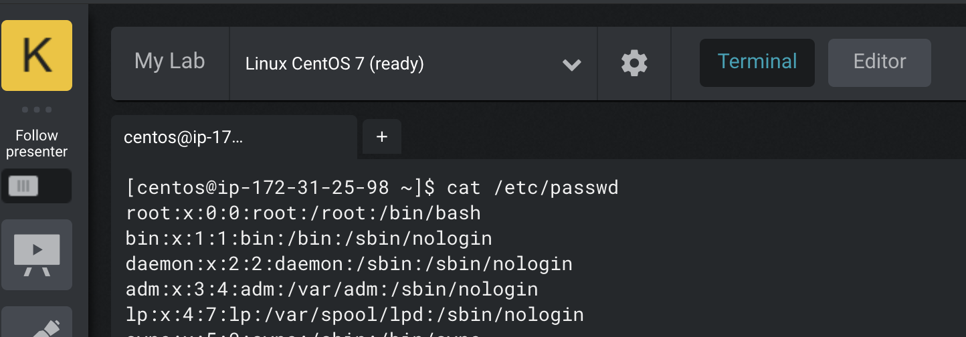
ATT&CK Technique: T1078 Valid Accounts
In strigo’s Linux lab terminal: cat /etc/passwd
1
Type ‘cat /etc/passwd’ in the terminal

Slide 13
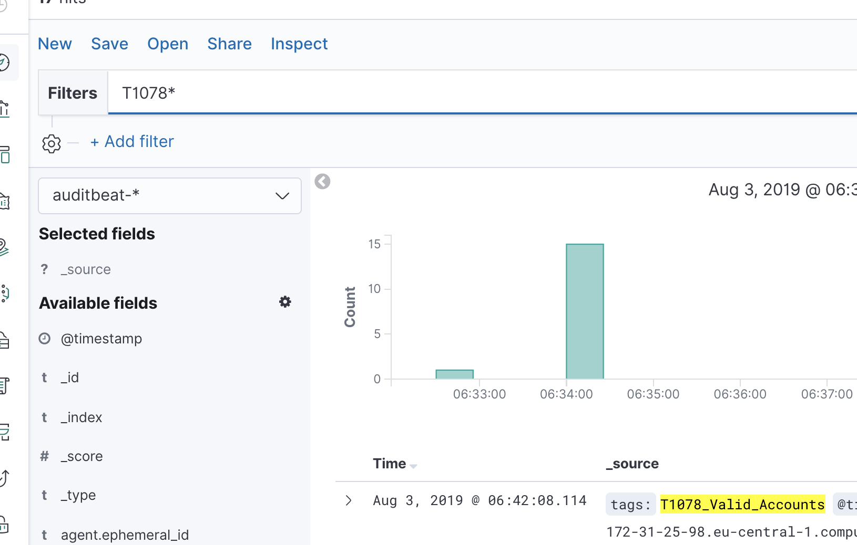
Find T1078 events
Search Using Wildcards
1
Search for ‘T1078’
2
Pro Tip: Avoid using ‘*’ as a prefix without a key (e.g. ‘*1078’)

Slide 14
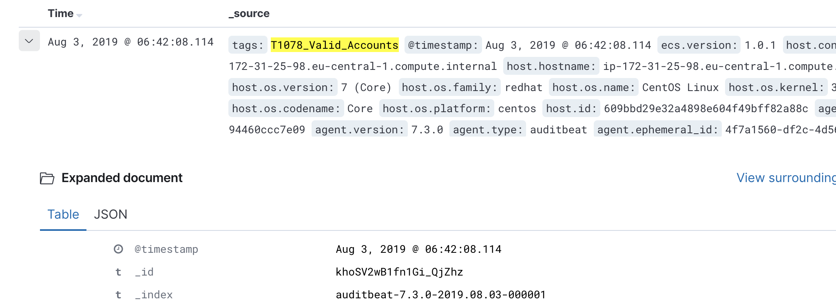
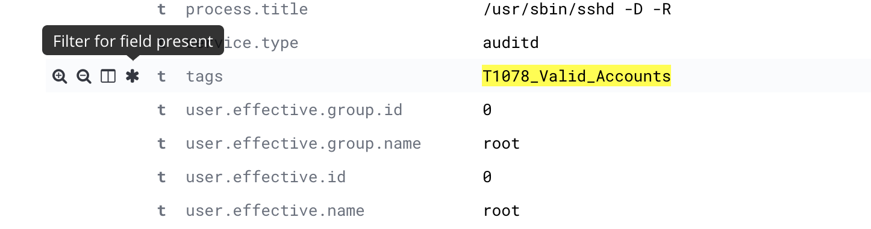
Inspect an event
Review the fields in an event, filter on ‘contains tag’
1
Select the drop down arrow icon next to a matching event.
2
Select the star icon to filter for events events that contain the ‘tags’ field
(filter for tag present)

Slide 15
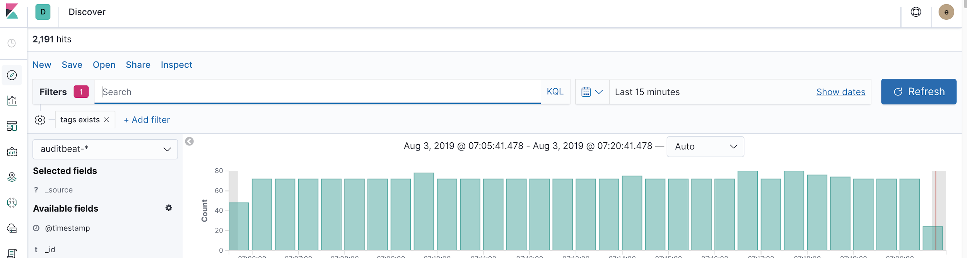
Apply tag exists filter
Clear the search box and refresh to see only results that contain ‘tag’
1
Clear the Search
field
2
Click Refresh
/Update

Slide 16
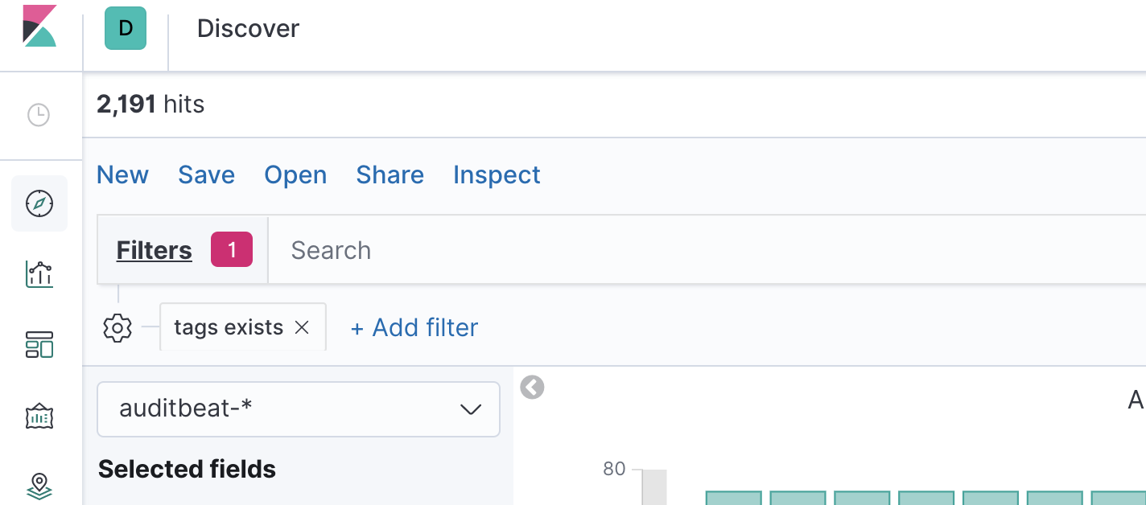
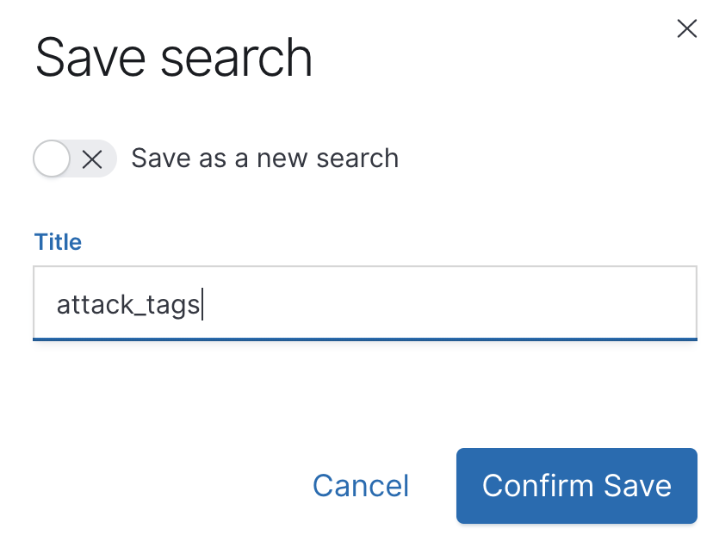
Create a Saved Search
Save your tags filter for reuse
1
Select Save
2
Name your saved search ‘attack_tags’
3
Select save

Slide 17
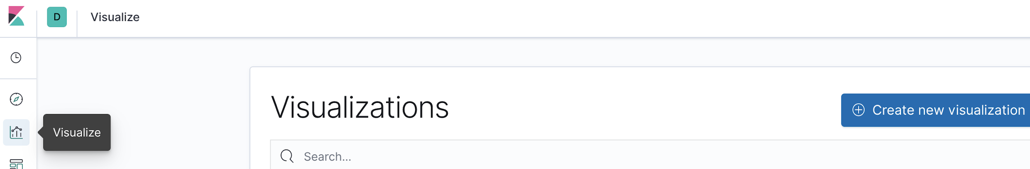
Start creating a new visualization
Create a new visualization in the Visualize Kibana app
2
Select Create new visualization
1
select the Visualize icon from the left app navigation menu

Slide 18
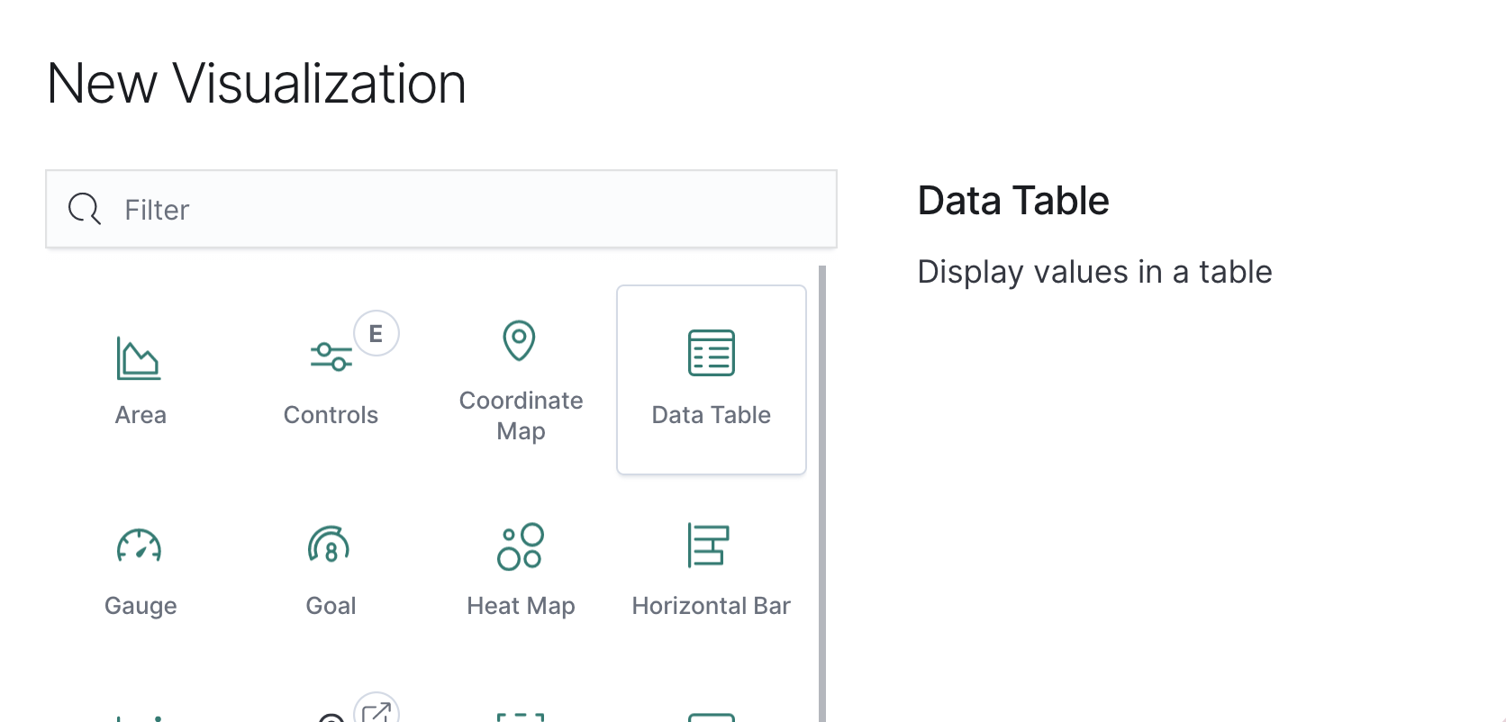
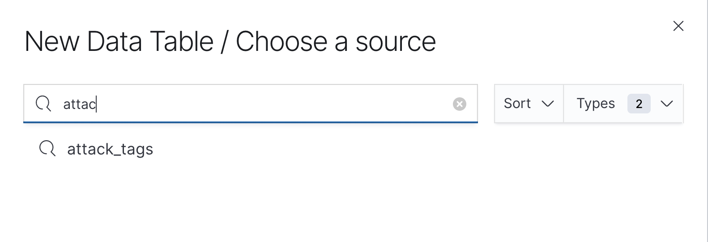
Create a new data table visualization
Reuse your ‘attack_tags’ saved search
1
Select the Data Table icon
2
Type ‘attac’ and select ‘attack_tags’

Slide 19
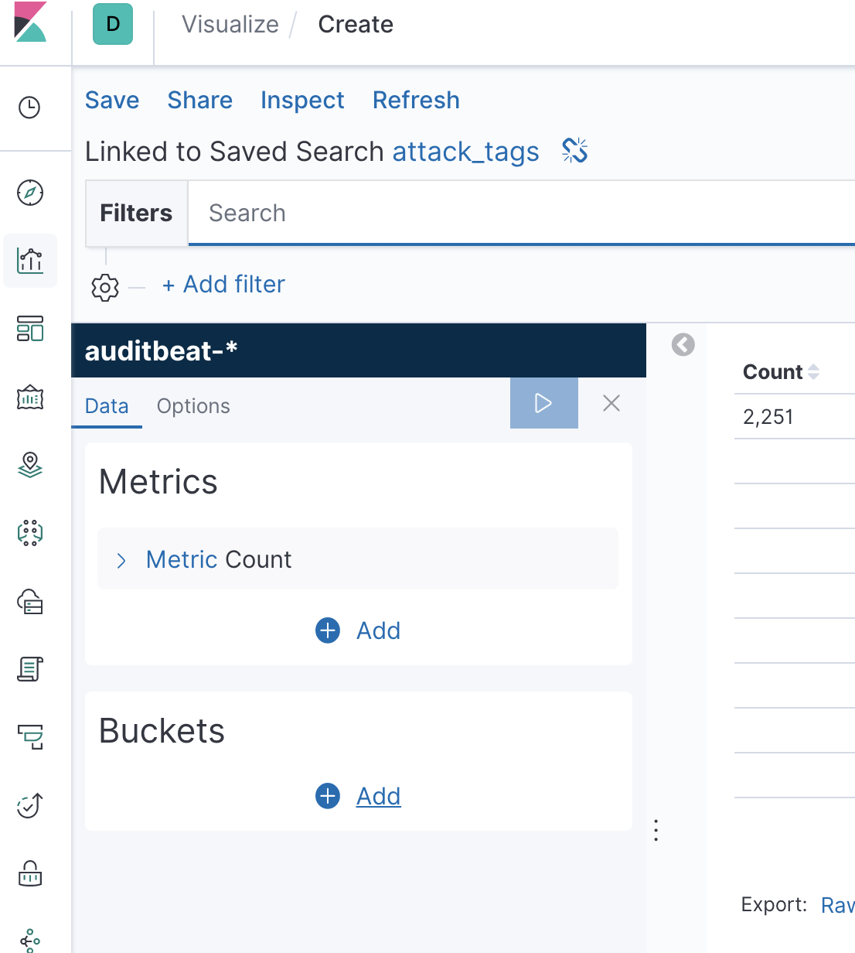
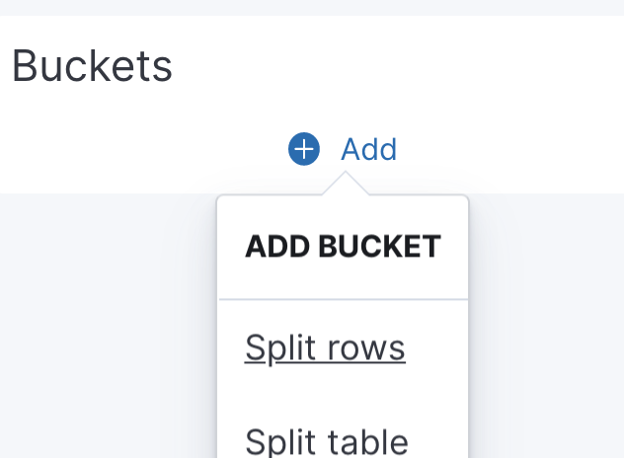
Editing Data Table
Split rows
1
Select Add under Bucket
2
Select ‘Split rows’

Slide 20
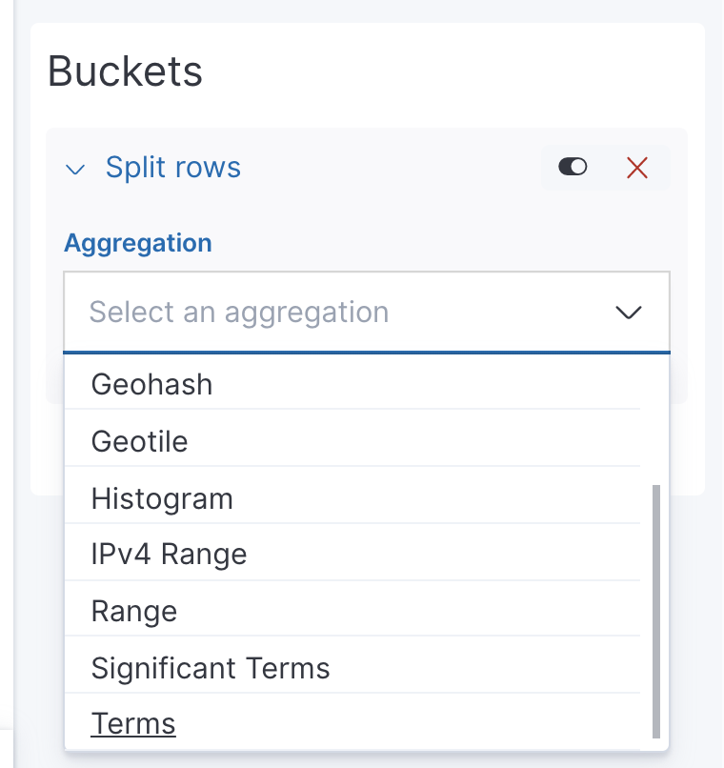
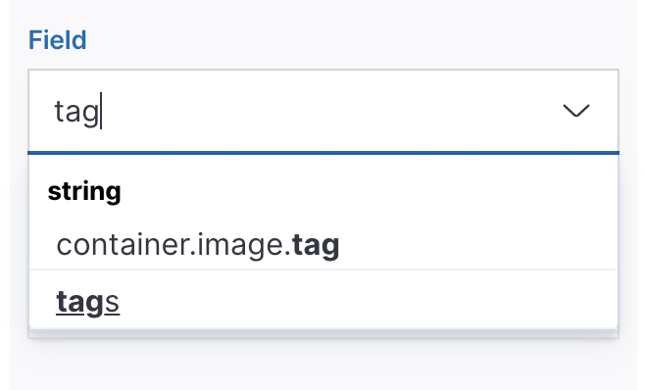
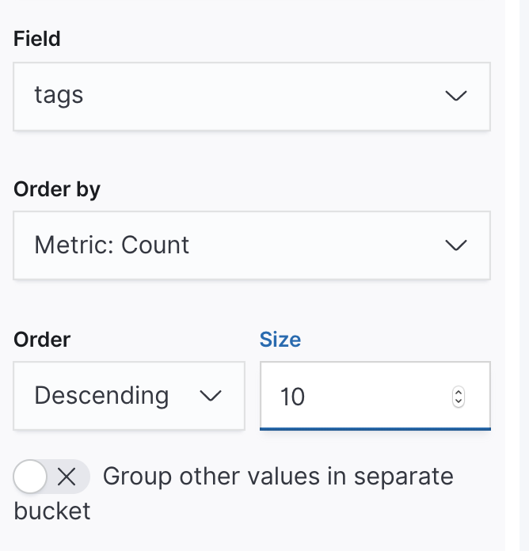
Editing Data Table
Use terms
1
Select the Terms Aggregation
2
Type ‘tags’ and select it for Aggregation Field
3
Set the Size to 10

Slide 21
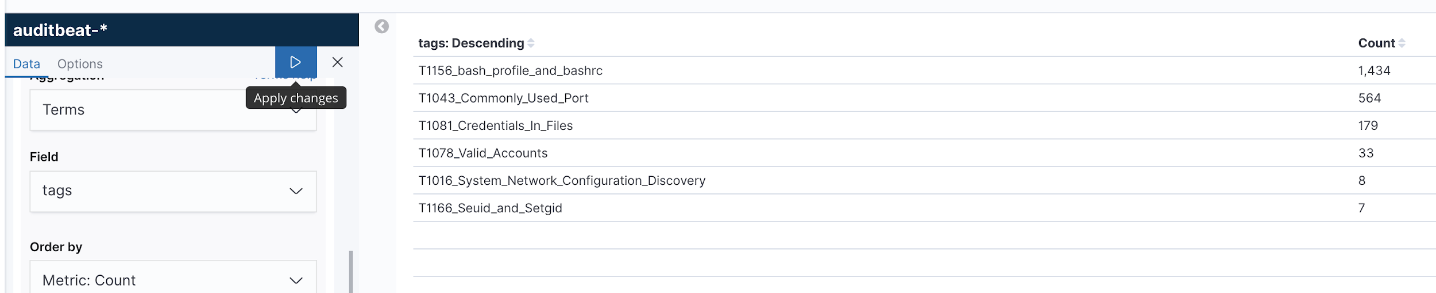
See your updated data table visualization
Apply you changes
4
Select Apply changes
5
Try sorting on the Count

Slide 22
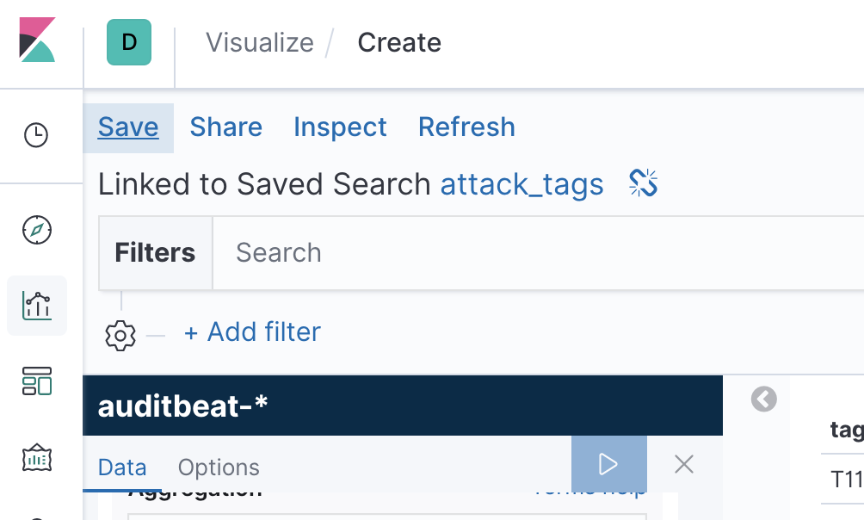
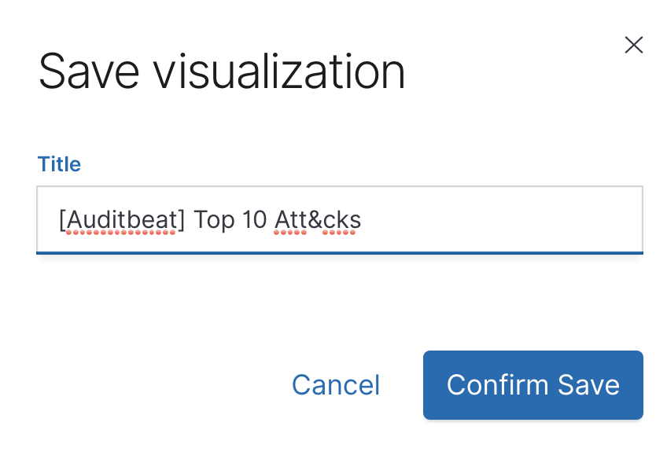
Save your visualization
Save your visualization for reuse
1
Select Save at the top left
2
Name your visualization ‘[Auditbeat] Top 10 Att&cks’
3
Select Confirm Save

Slide 23
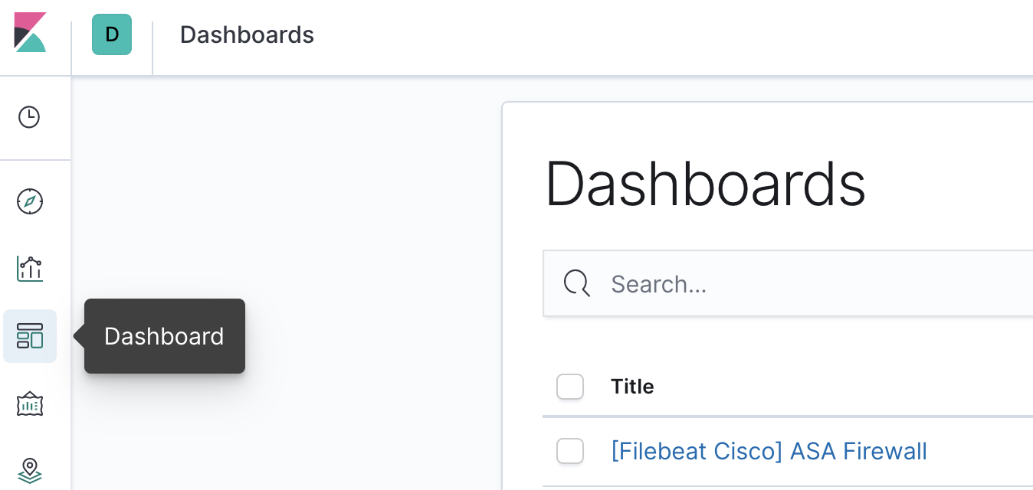
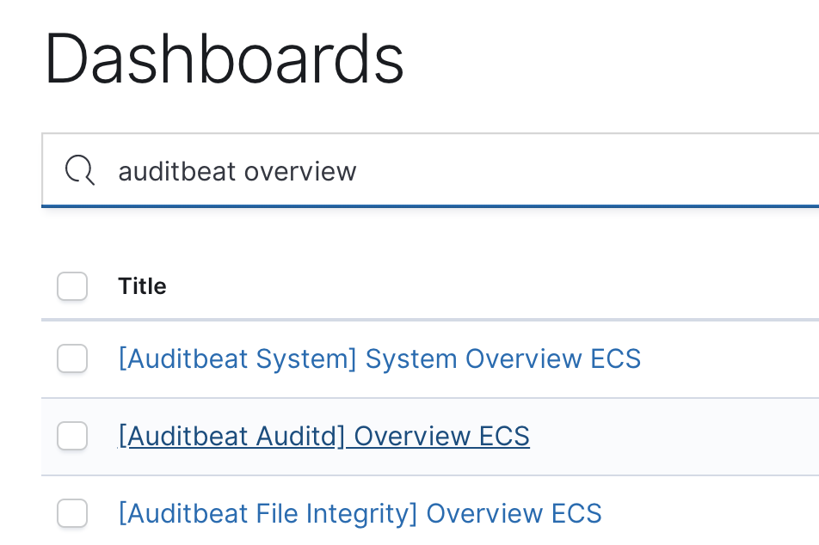
Add visualization to Auditbeat Overview
Navigate to the ‘[Auditbeat Auditd] Overview ECS’ dashboard
1
Select the Dashboard icon from the left navigation menu
2
Type ‘auditbeat overview’ in the Dashboard search box
3
Select ‘[Auditbeat Auditd] Overview ECS’ from the menu

Slide 24
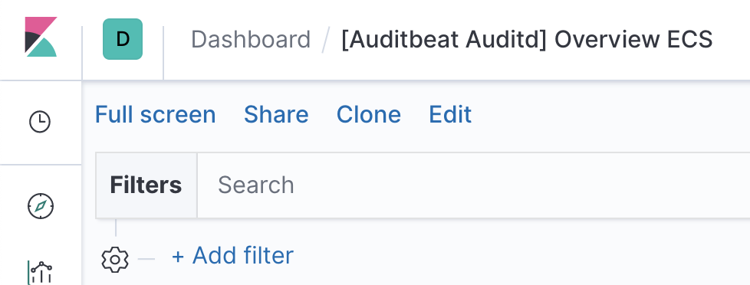
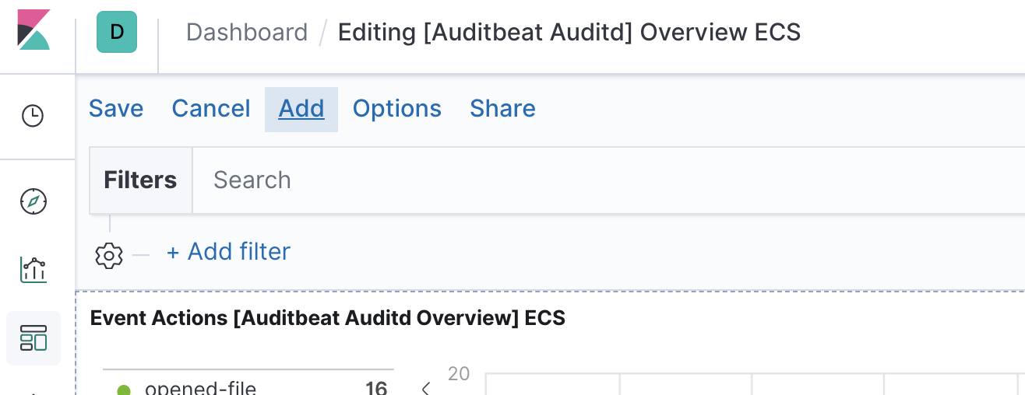
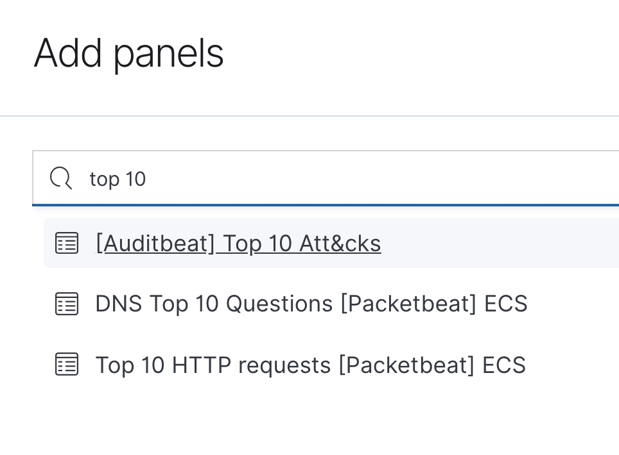
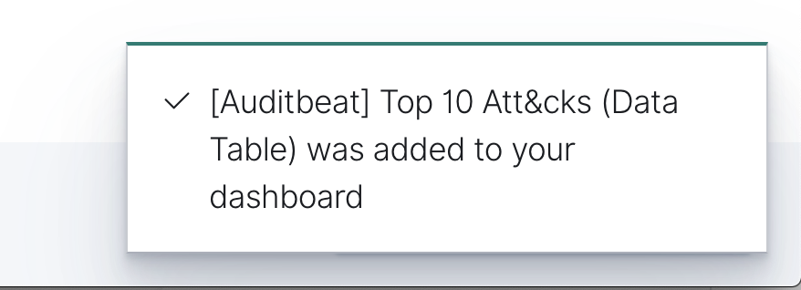
Add visualization to Auditbeat Overview Dashboard
Finish adding visualization
1
Select Edit from the top navigation menu
2
Select Add from the top navigation menu
3
Type ‘top 10’ into the Add panel search box in the left side fly-out
4
Select ‘[Auditbeat] Top 10 Att&cks’ from the drop down

Slide 25
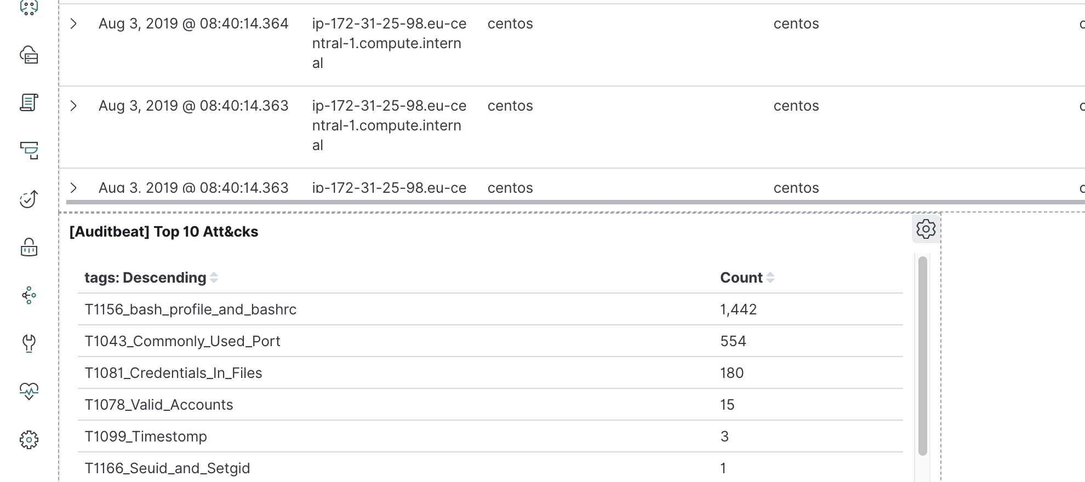
View the visualisation on the updated Dashboard
1
Exit the Add Panel fly-out
2
Scroll down to the very bottom of the dashboard to find your visualization

Slide 26
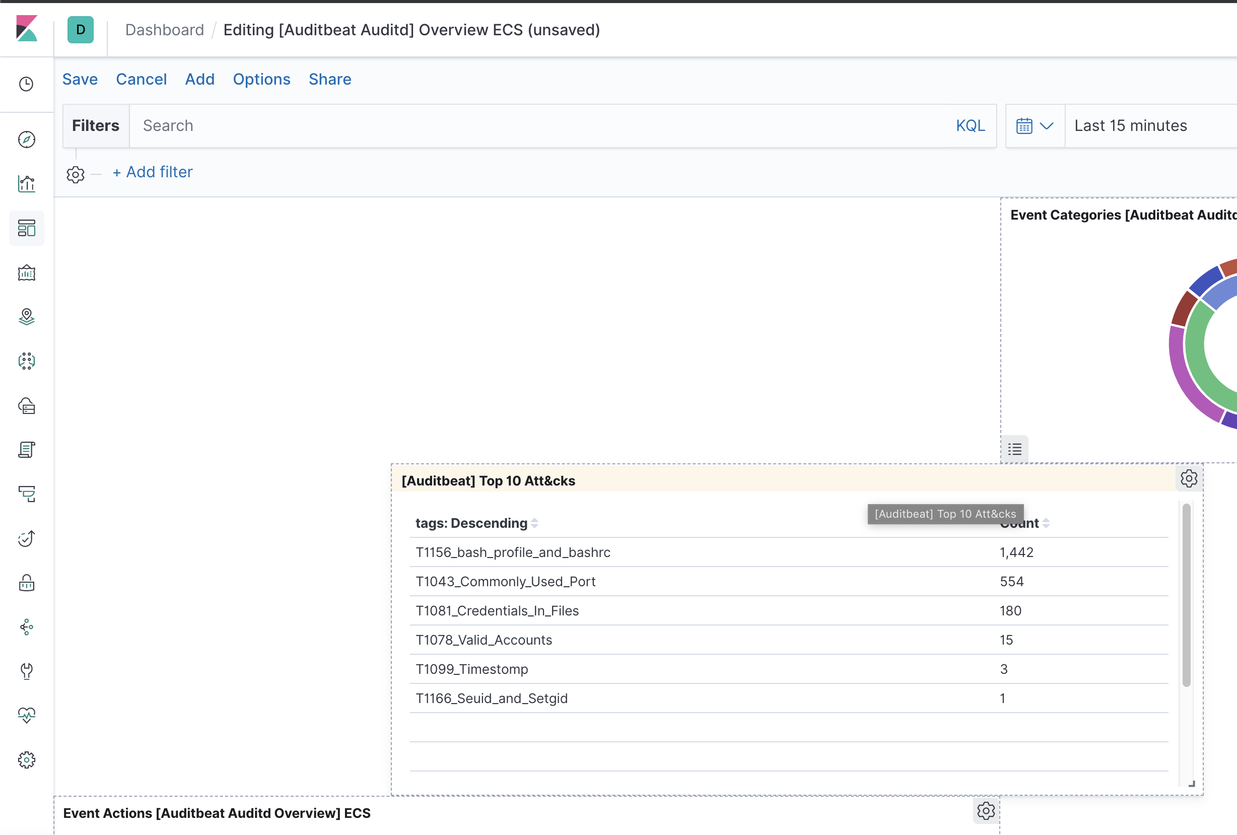
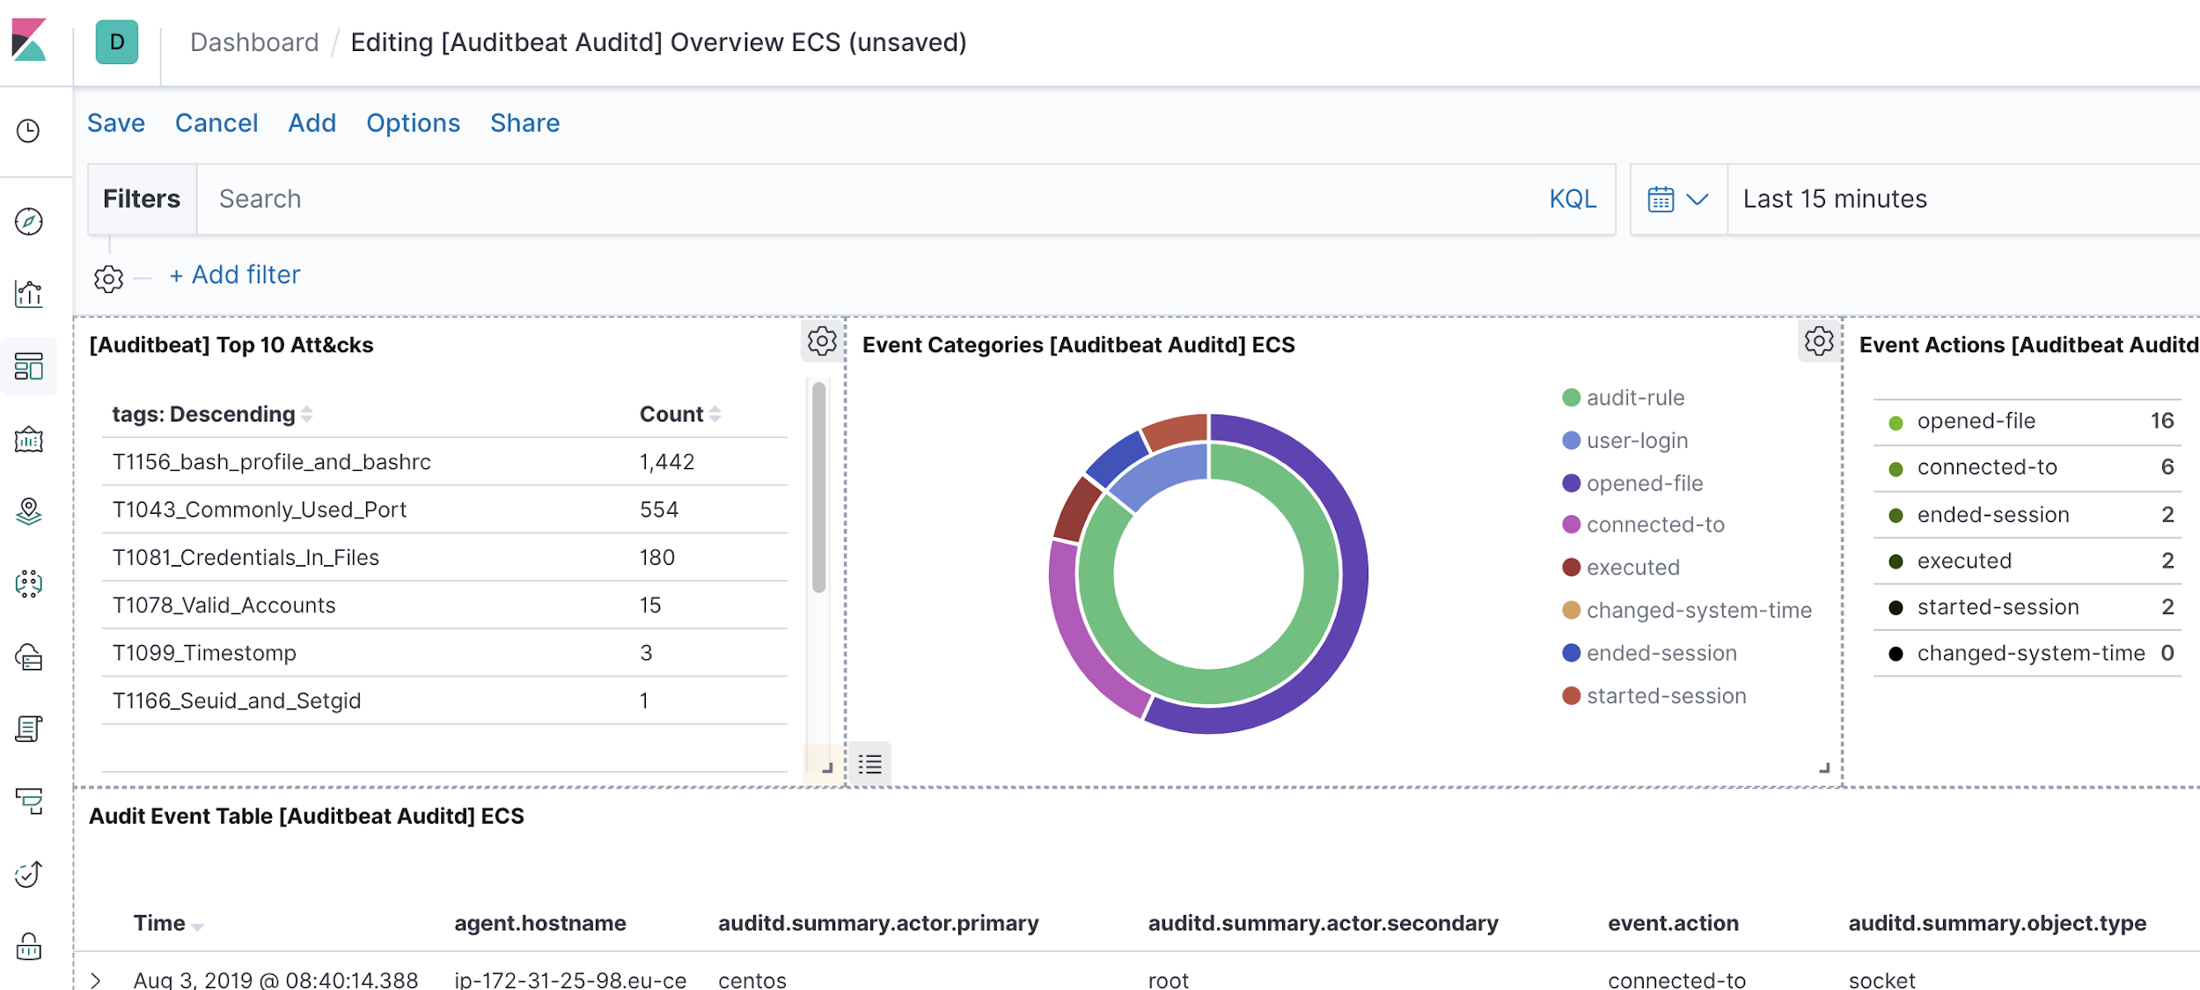
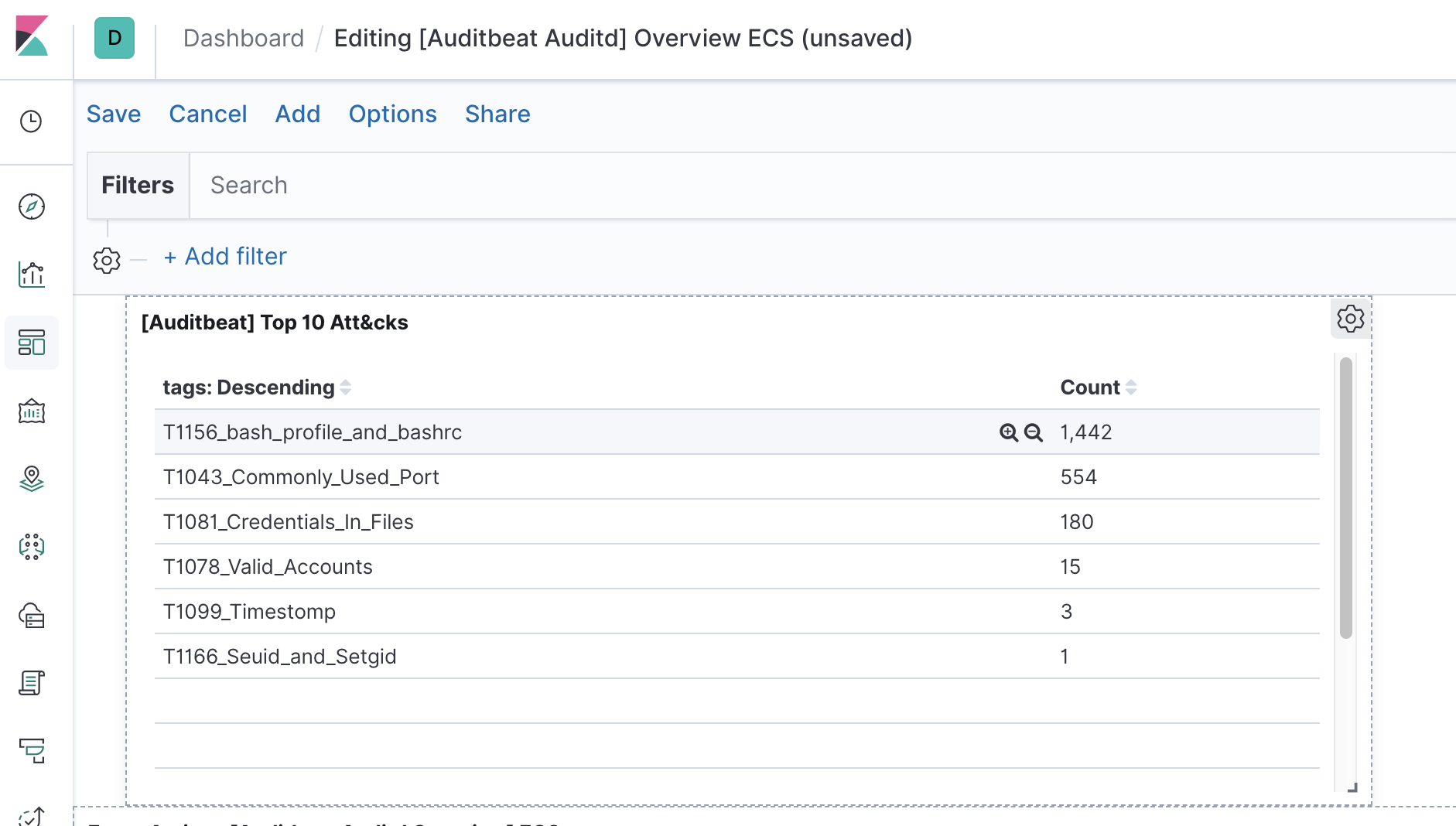
Reshaping the dashboard
Changing the layout of a dashboard
1
Drag the visualization to the top by dragging while holding the left click button down.
3
Resize other visualizations to
better fit the screen
2
Resize the panel using the lower right resize arrow

Slide 27
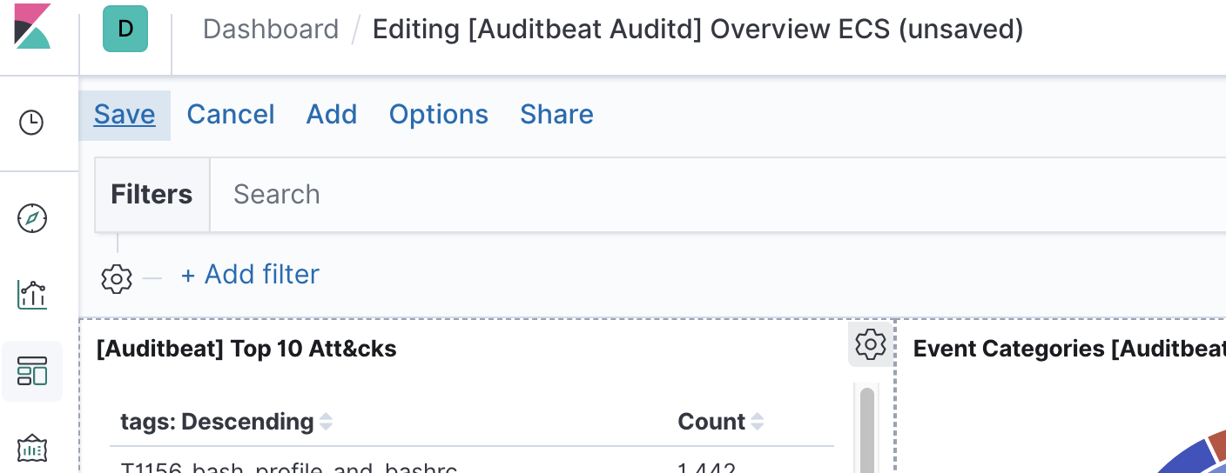
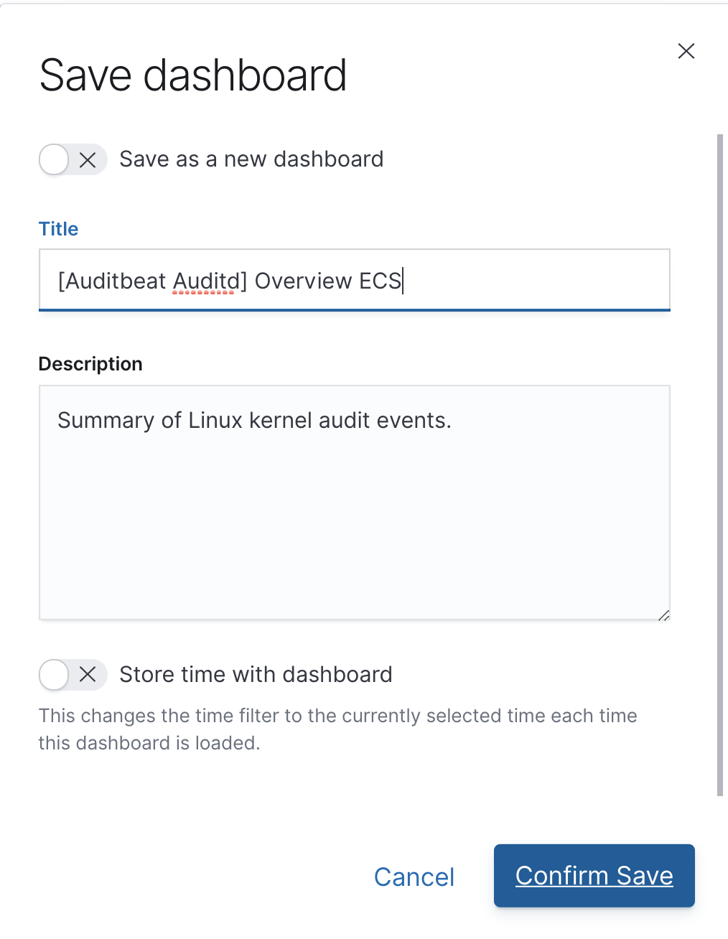
Save your Updated Dashboard
Top 10 attacks added to Auditbeat Overview
1
Select Save in the top left
2
Leave the existing name
3
Select Confirm Save

Slide 28
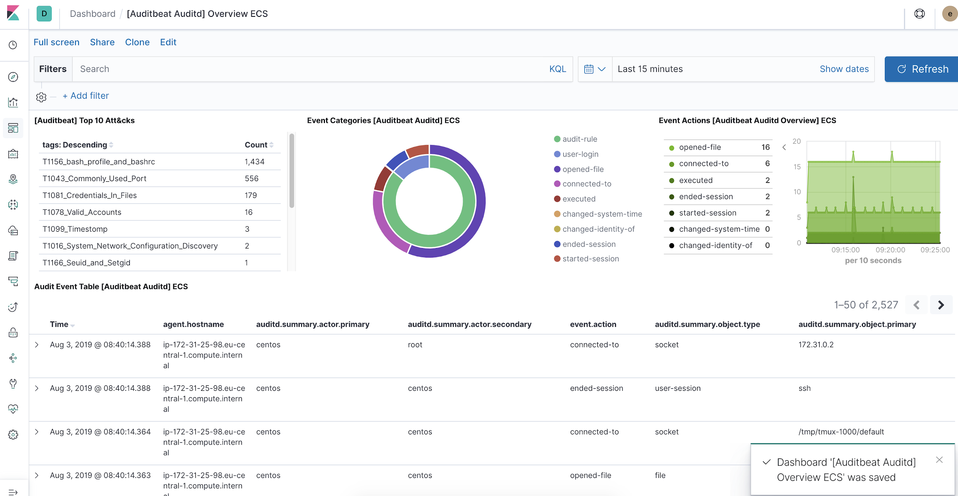
Play time
Click around with ‘+’ to filter data instantly
2
Select the ‘+’ icon to create filters automatically
1
A saved tool tip should appear

Slide 29
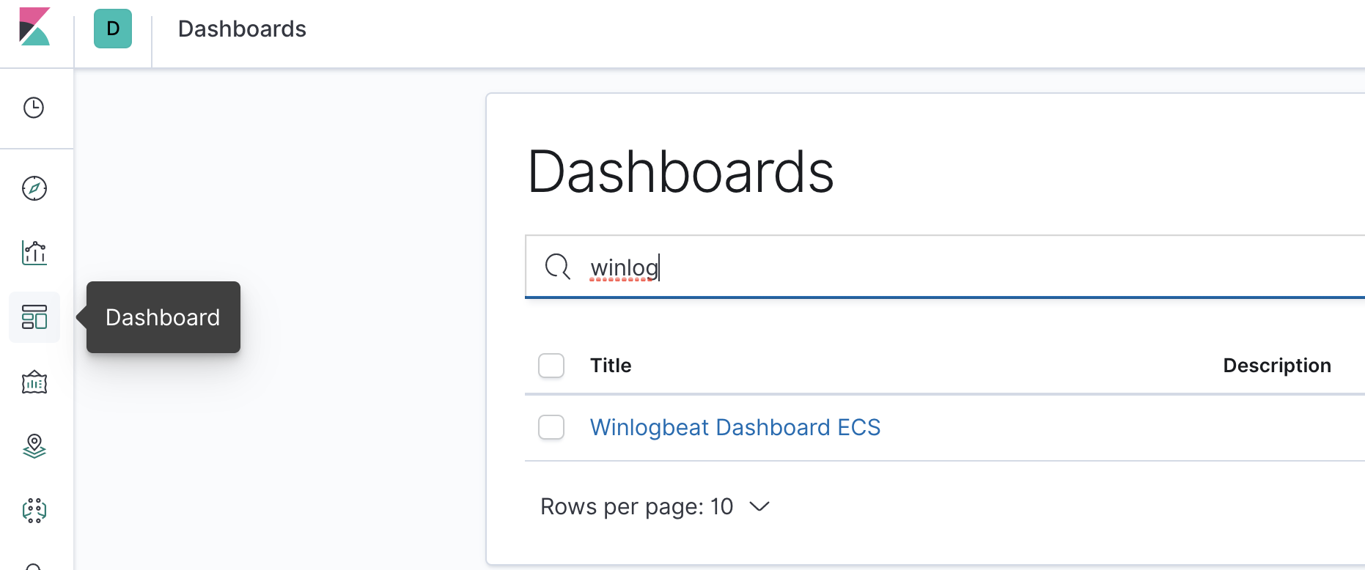
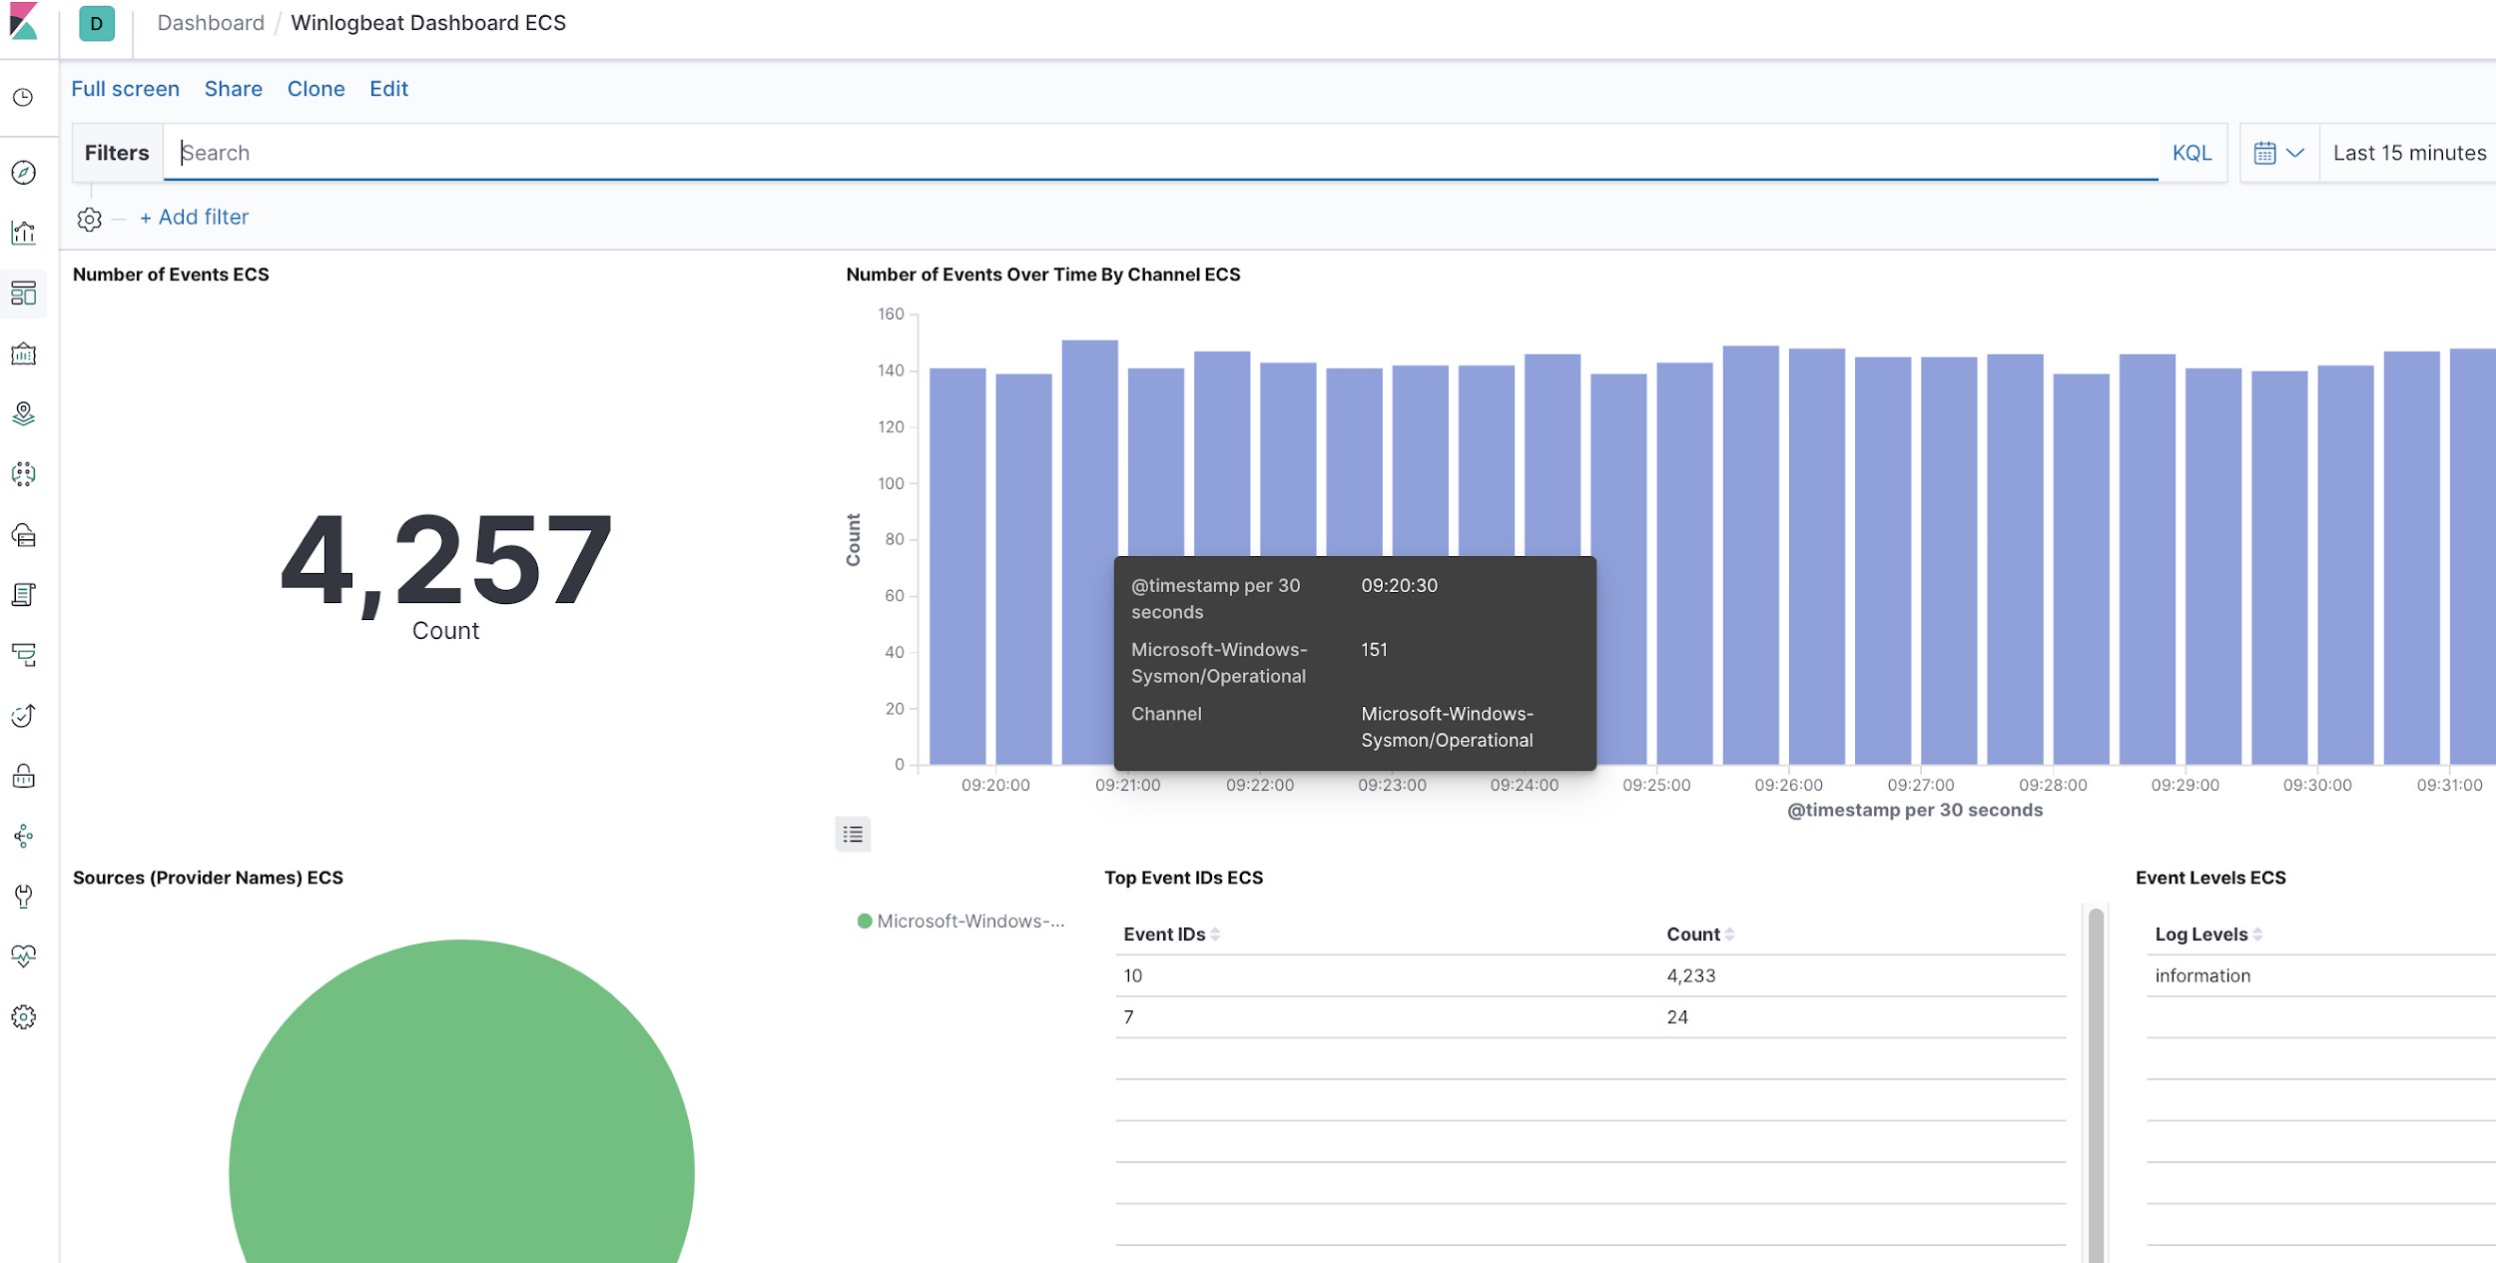
Other Dashboards
Click around with ‘+’ to filter data instantly
1
Click the Dashboard icon
2
Type winlog and Select ‘Winlogbeat Dashboard ECS’ from the menu
332
Explore filtering using the ‘+’ icon
4
Checkout Metricbeat and Packetbeat dashboard by searching for them!

